Slide 1

Interim Presentation
Developing a Full-Stack Web Application with OCR Functionalities
Clemente Gonzales – N00193107

Slide 2
Project Background
The project will be a web based application
Containing an OCR functionality
A notes taking application
Application should contain a user-friendly design

Slide 3
Existing Applications
Notion
Google Keep
Evernote
Text Scanner [OCR]

Slide 4
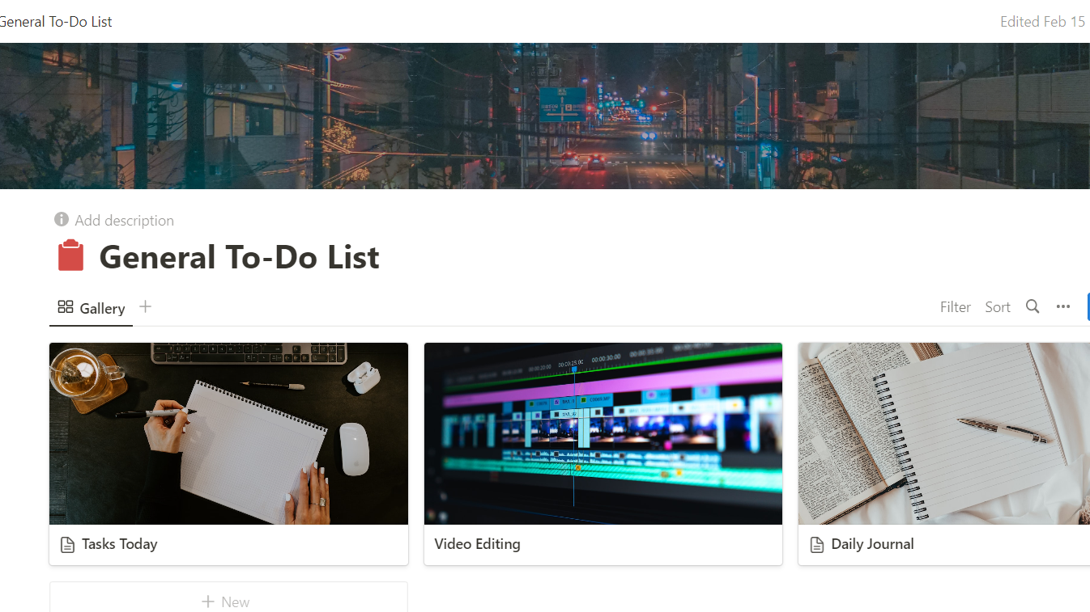
Notion

Slide 5
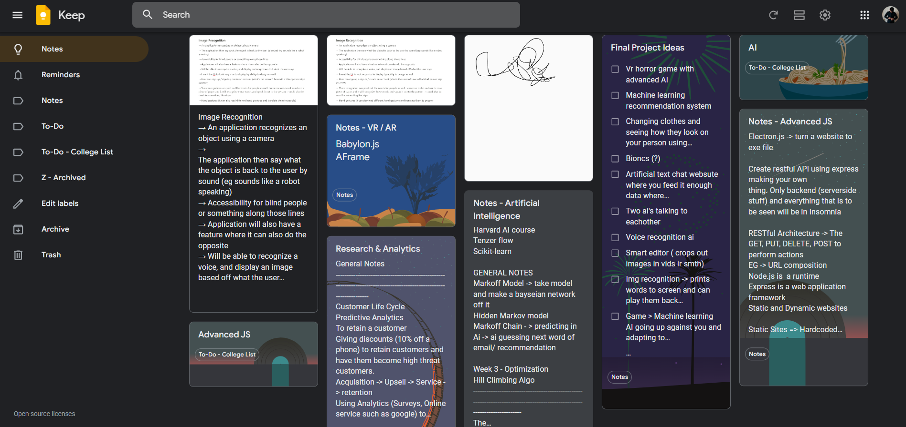
Google Keep

Slide 6
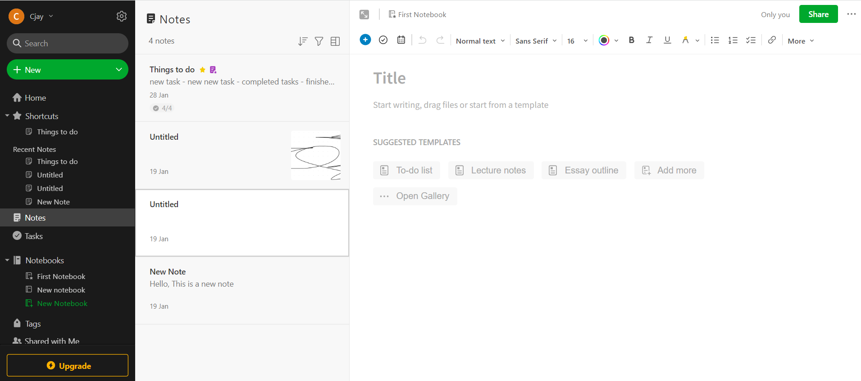
Evernote

Slide 7
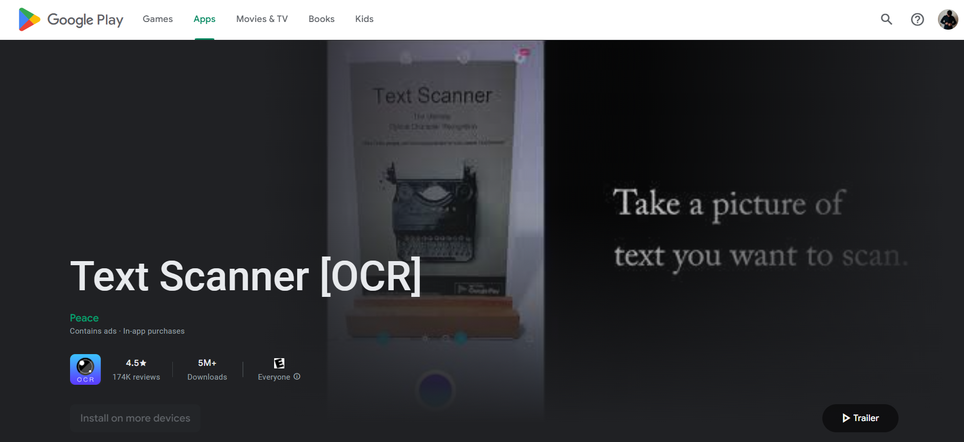
Text scanner [ocr]

Slide 8
Research
Interviews
Viewing Similar Applications
Survey

Slide 9
Technologies
React.js
MERN Stack
Tesseract OCR
Quill.js
Figma

Slide 10
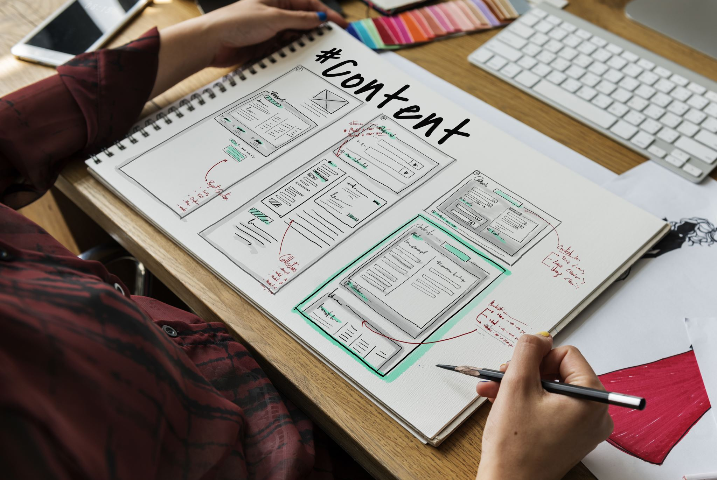
Implementation Plan

Slide 11
Sprints
Sprint 1 – Research and Prototype OCR Functionality
Sprint 2 – Design the User Interface and Backend of Application
Sprint 3 – Prototype Development of Text Editor and Folder Structure
Sprint 4 – Complete the development of Backend
Sprint 5 – Connect the existing prototypes together to create a skeleton
Sprint 6 – Begin implementing design of application
Sprint 7 – Add React Native to allow for mobile compatibility
Sprint 8 – Implement extra features where possible
Sprint 9 – Implement extra features where possible

Slide 12
Work in progress demonstration

Slide 13

Questions?

Slide 14
Thank you!

